Slide 1

Shiny
Web development through R

Slide 2
Outline
Workshop sessions
Introduction, Structure & Basics - 10th Jan
– Widgets, basic apps and how to share them
More advanced elements – 17th Jan
– Layout, themes & dashboards, formatting, mapping, plots and tables
Interactivity and renderUI – 24th Jan
Troubleshooting & “BYO-App” session Fisheries Informatics project – 31st Jan
– Optional hands on session
Github session

Slide 3

Session 1
Outline
Introduction to shiny
Structure & Basic code template
Widget examples
6 basic apps
Sharing apps
Fisheries Informatics apps
- Interesting functionalities

Slide 4

Shiny!

Slide 5
Shiny
What is it?
An R package that makes it easy to build interactive web applications (apps) straight from R.
Combines the computational power of R with the interactivity of the modern web.
Can host standalone apps on a webpage, embed them into R markdown documents or build dashboards
Extend your shiny apps with
CSS themes
Html widgets
JavaScript actions

Slide 6
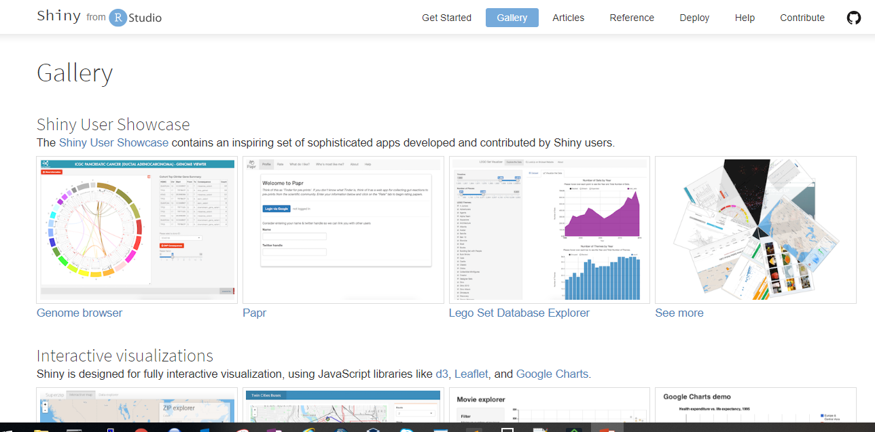
Shiny - options

Slide 7
Structure
ui
What it looks like
app.R
(R script)
What it does
server
Makes it work
shinyApp(ui,server)

Slide 8
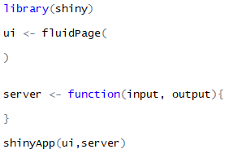
Basic App Template
Load required packages
Construct the layout and structure (more options in session 2)
A function with instructions on how to build and rebuild the R objects displayed in the ui
Function combining the two sections into a functioning app

Slide 9
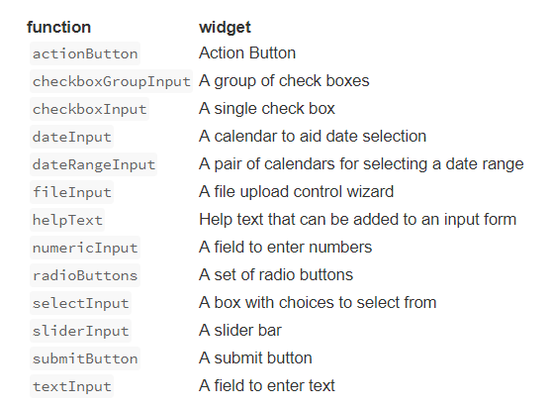

Widgets
Visible app element that your user can interact with
Widgets need;
A name for the widget. The user will not see this name but you can use it to access the widgets value and create reactive elements based on it. This is the inputId or outputId
A label. This should be a character string and will appear with the widget in your app. it can be an empty string “”.
In this example the name is “action” and the label is “Action”
Notes:
InputId is what the app recognizes the element by, it’s ‘name’ within the code
The label is what is displayed on the app and this is optional

Slide 10
ui
Add inputs to the ui with *Input() functions
e.g. numericInput( inputId = ‘n’, label = ‘Sample Size’, value = 25)
Add outputs to the ui with *Output() functions
e.g. plotOutput( outputId = ‘histogram’)

Slide 11
server
Tell the server how to render outputs in R by;
Referring to outputs with output$<outputId / name>
e.g. output$histogram
Referring to inputs with input$<inputId / name>
e.g. input$n
Wrap this inside a render*() function before saving to output.
e.g. output$histogram <- renderPlot({ hist(rnorm( input$n )) })

Slide 12
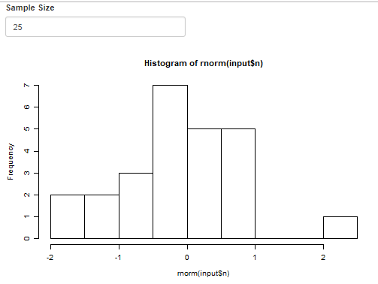
Result

Slide 13
Full code
library(shiny)
ui<-fluidPage(
numericInput( inputId = 'n', label = 'Sample Size', value = 25),
plotOutput( outputId = 'histogram')
)
server<-function(input, output){
output$histogram <- renderPlot({ hist(rnorm( input$n )) })
}
shinyApp(ui,server)

Slide 14
Now you…
Examples 1-6

Slide 15
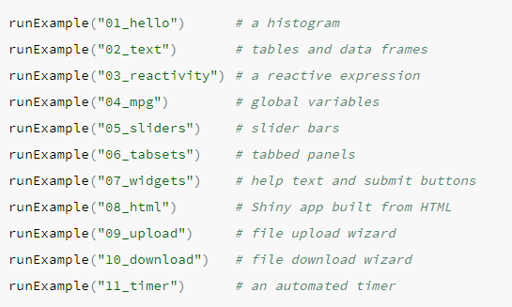
Examples - Built in

Slide 16
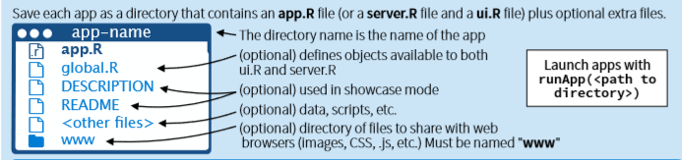
Sharing your apps
R scripts
This is the simplest way to share an app, but it works only if your users have R on their own computer (and know how to use it).
Users can use these scripts to launch the app from their own R session, just like you’ve been launching the apps so far in this tutorial.
Need a copy of your app.R file, as well as any supplemental materials used in your app (e.g. the ‘www’ folder etc.)

Slide 17
Sharing your apps
Web page
This is definitely the most user friendly way to share a Shiny app. Your users can navigate to your app through the internet with a web browser. They will find your app fully rendered, up to date, and ready to go
Rstudio offers 4 ways to host your Shiny app as a web page;
shinyapps.io
Shiny Server
Shiny Server Pro*
RStudio Connect*
*for closer control, larger volumes and requires purchase

Slide 18
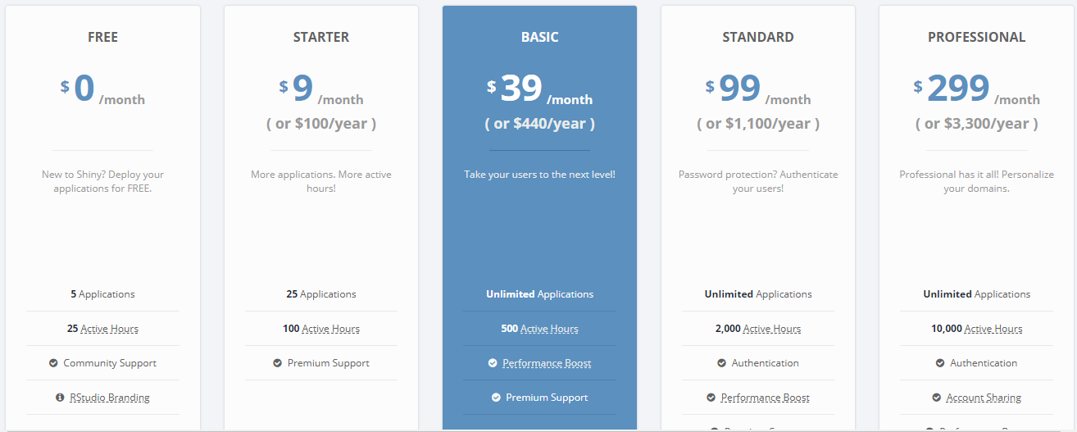
Shinyapps.io
Create a free or professional account at http://shinyapps.io
Click the Publish icon in the RStudio IDE (>=0.99) or run: rsconnect::deployApp("<path to directory>")

Slide 19

Fisheries Informatics Project
MI based project aiming to visualize existing data, increase its usage/utility and make it more easily accessible.
Outputs;
Species Dashboard
Digital Stockbook
IGFS data explorer
Cod tagging data portal

Slide 20
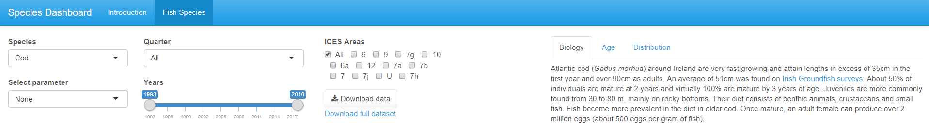
Species Dashboard
Pop-up message
Multiple tabs and complex ui structure
Interactive plots
showModal(modalDialog(
title = "Please note",
"This app is best viewed using Google Chrome",
footer = modalButton("OK"),
easyClose = TRUE
))
Explore more in layout section – Session 2
Full plotly explanation in session 2

Slide 21
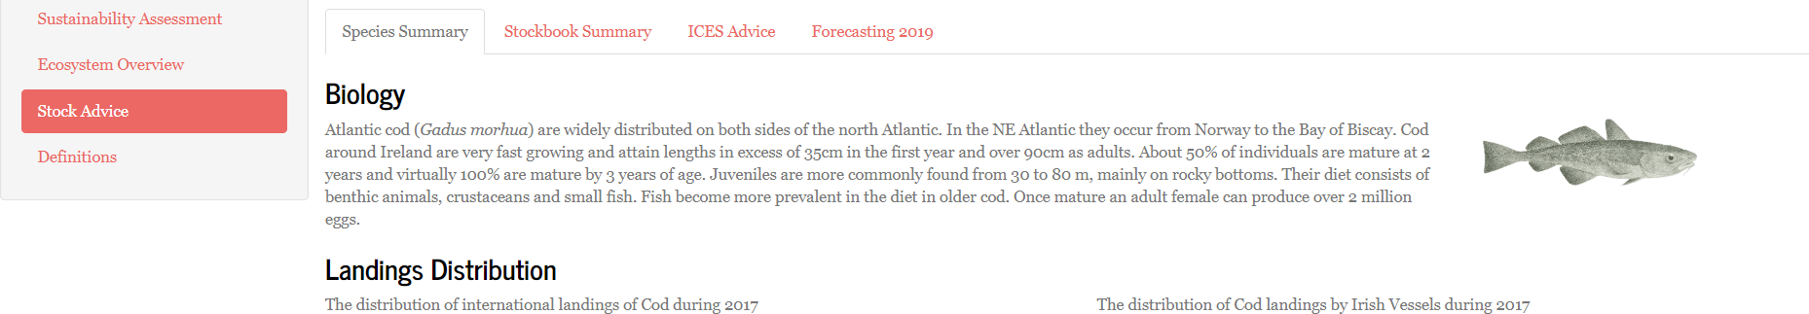
Digital Stockbook
Reactive filters
Layout
Reactive content
Selecting Stock different dropdown options based on species selected
renderUI
Multiple tabs – session 2
renderUI – session 3

Slide 22
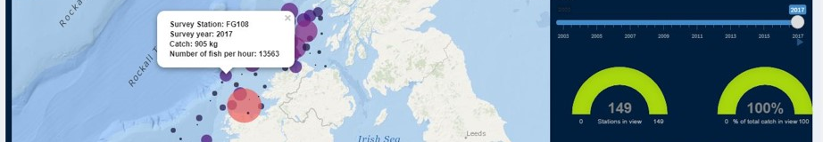
IGFS Data Explorer
Leaflet
View & download PDF
Reactive charts and infoboxes - UI
output$map <- renderLeaflet({
leaflet() %>%
addProviderTiles(providers$Esri.OceanBasemap) %>%
setView(lng = -8.2124, lat = 53.2734, zoom = 6)
})
observeEvent(input$modal1,{
showModal(modalDialog(
tags$iframe(style="height:800px; width:100%; scrolling=yes",
src=“myfile"),
title= “title",
easyClose = TRUE,
footer = NULL))
})
dashboardPage(
dashboardHeader(disable = TRUE),
dashboardSidebar(disable = TRUE),
dashboardBody(
fluidPage(fluidRow(valueBoxOutput("box1"),
valueBoxOutput("box2"),
valueBoxOutput("box3")
),

Slide 23
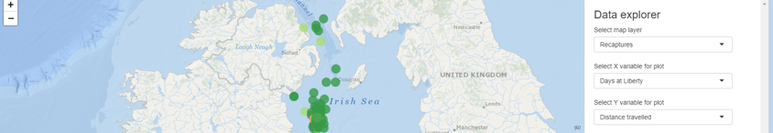
Cod tagging
Leaflet + adaptive page
Download map
leafletOutput(outputId = "map", width = "100%", height = "100%"),
absolutePanel(id = "controls", class = "panel panel-default", style = 'overflow-y:scroll;max-height:575px;', fixed = FALSE, draggable = FALSE, …)
downloadHandler(…)
Creates filename and writes content of file
downloadButton(outputId = "dl", label = "Download Map")

Slide 24
Session 2
Outline
Layout options
Themes & dashboards
HTML formatting
Adding links, images, PDFs
Mapping with Leaflet
Plots with plotly and ggplot
Tables with Datatable

